Slide 1
Simplifying SQL Server Migrations using PowerShell
Chrissy LeMaire, PowerShell MVP
* Deck optimized for redistribution. Please see notes.
Notes:
This slide deck is intended to be as useful as possible, even if you were not at the session. Most slides have a comprehensive notes section.
If the font does not install automatically for you, please take the time to download it or the deck will be distractingly ugly. The Ubuntu font is free and is used within all PsConf.eu slide decks. The Font Awesome font is also free (and awesome.)
http://font.ubuntu.com/
https://fortawesome.github.io/Font-Awesome/
Enjoy!

Slide 2
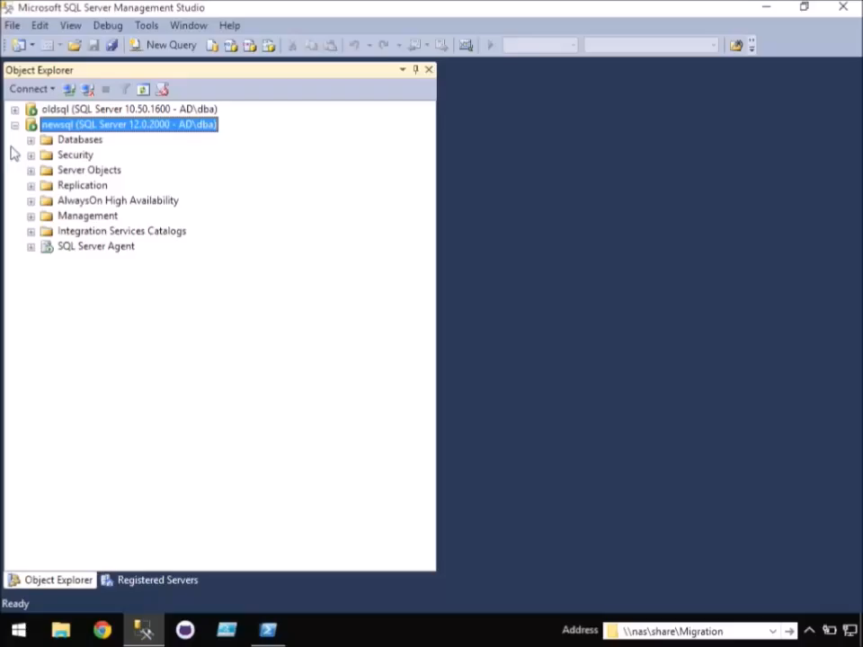
-WhatIf
Notes:
What if migrating a SQL Server instance was as simple as this?

Slide 3
Agenda
Why
What
Considerations
How
Demos
Notes:
The SQL Server migration coverage is as in-depth as possible, and should be useful even for accidental DBAs.

Slide 4




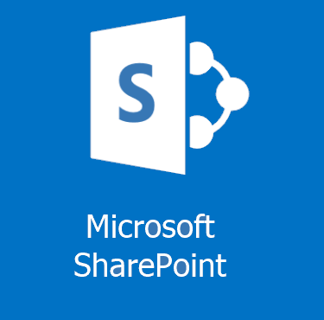

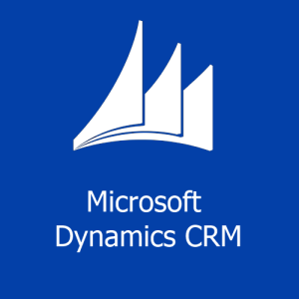
Why
Misconfiguration
HA Strategy Changes
Consolidation
Best Practices
Platform Changes
versions, hardware,
virtualization, cloud
Notes:
Misconfigured SQL Servers: In environments without dedicated database administrators, SQL Server is often installed by general technicians who do not optimize the system to deliver peak SQL Server performance. Organizations may also need to move to a different server collation.
Consolidation: Cost savings, reduce administrative overhead. @sql_williamd speaks about this topic at length. http://www.sqlpass.org/EventDownload.aspx?suid=7322
Change in HA Strategy: Organizations may decide on a new High Availability strategy, such as going from a failover cluster instance to AlwaysOn. Or they may migrate from a clustered instance, to a stand-alone instance, and handle their HA outside of Windows and SQL Server.
Resource Requirements/Best Practices: As an organization’s data requirements grow, SQL Server may outgrow the server on which it was originally built. This has a greater impact on non-virtualized environments, but virtualized servers may also be impacted by resource requirements when one server runs multiple instances of SQL Server, and one instance must be moved to a new server.
SQL Server/OS Upgrade: In-place upgrades are possible for both SQL Server and Windows, but are not ideal for every environment. Physical -> Virtual, or to the cloud, or even dev/test/staging.

Slide 5
What
Databases
Logins
Jobs & Schedules
Server Configurations
Linked Servers
Credentials
Reporting Services
Integration Services
Maintenance objects
Availability Groups
Replication Settings
Central Management Server
Operators
Alerts
Proxies
Certificates
Policy Management
Resource Pools
... not an exhaustive list
Notes:
There’s a lot to migrate. Pretty much everything you see in SQL Server Management Studio can and perhaps should be migrated.
Server Configs include things like like backup compression defaults, enabling the CLR, etc.
Maintenance objects include things like Ola Hallengren’s backup scripts in the msdb database.

Slide 6
Considerations
Databases
Logins
Complex file structures, filestreams, full-text indexes, edition differences, version compatibility settings, server collation, mirroring, broker-enabled, trustworthy, read-only, owner, exists at destination, owner chaining, associated logins, jobs, certs, linked servers, etc.
SIDs, passwords, server roles, server permission sets, credential mapping, password complexity & expiration, default db, owned databases, status, default language, certificate mapped, exists at destination, login type, destination login mode, version/hash compatibility, etc.
SQL Agent Objects
Linked Servers
related databases, logins, credentials, schedules, disabling on source
OLEDB provider & driver availability, local files, remote login passwords
Server Configs
Connstrings
Edition differences (Enterprise -> Std.) Version differences
Which applications & logins are connecting from which hosts?
... not an exhaustive list
Notes:
My point is, there’s a lot to think about. And this slide doesn’t even begin to cover it. This underlines why automation is so important. There’s less room for human error because the same checks are run each time, every time.
Databases
Complex file structures, filestreams, full-text indexes, edition differences, version compatibility settings, server collation, mirroring, broker-enabled, trustworthy, read-only, owner Availability Groups, replication, associated logins, jobs, certificates, packages, linked servers, post migration actions, reattach at source, set source read only, database state, log shipping, currently connected users, is system db, exists at destination, owner chaining, etc.
Logins
SIDs, passwords, server roles, server permission sets, credential mapping, password complexity & expiration, default db, owned databases, status, default language, exists at destination, login type, destination login mode, version/hash compatibility, related objects like jobs, can’t drop if schema owner or assigned a permission set, does windows login exist at destination, skip built in accounts, certificate mapped, asymmetric keys, and so on.
SQL Agent Jobs
related databases, logins, credentials, schedules, disabling on source
Linked Servers
OLEDB provider & driver availability, local files, remote login passwords
Server Configs (sp_config)
Edition differences (Enterprise -> Std.) Version differences
Connstrings
Which applications & logins are connecting from which hosts?
Fun lists
http://www.karaszi.com/sqlserver/info_moving_database.asp
http://yrushka.com/index.php/sql-server/database-recovery/sql-server-migration-from-one-server-to-another-detailed-checklist/
http://www.littlekendra.com/2016/01/12/whitepapers-for-planning-sql-server-migrations/
http://passmedia.sqlpass.org/media/24hours/2012_fall/PDF/02.pdf
Webcast
Kendra Little’s migration video
https://www.veeam.com/videos/sql-server-2005-migration-checklist-7008.html

Slide 7
Database migration methods
Backup and restore - well-suited for many situations - solid and straightforward - labor intensive, can be scripted
Detach, copy, attach - solid, but labor intensive - drops some attributes - increased downtime
Import Export Data Wizard - slow - can be messy & error prone - loses attributes and logins
Log Shipping - ideal for large databases - solid, but complex - edition & version combo concerns
Mirroring - ideal for large databases - most complex - edition dependent
Copy Database Wizard - decent for small migrations - prone to typos and errors - drops some attributes - dependencies often error out
... not an exhaustive list
Notes:
Backup / Restore
maintains most of the database attributes, except for db owner
Ideal for going between different editions like Express and Enterprise, and also different SQL Server versions.
When compression is enabled, it can actually be one of the faster ways to migrate a database.
Detach / Attach
Time consuming - it copies over white space unlike backup and restore, and you might have to traverse through deep directory structures when you're copying over data and log files.
Import / Export Wizard * SMO / not same database in the end
Has been described as "torturous" to use. I've actually never even used this in production, so I'll just skip this one.
Log shipping (initially uses backup/restore)
Cutover time is drastically reduced, especially when you compare it to the two previous methods. However, it is a little more complex, and it may not be supported by all SQL Server Edition and Version combinations. Nowadays, most often used temporarily, especially for migrations.
Classic Mirroring and AlwaysOn Advanced Mirroring (initially uses backup/restore)
Edition dependent, so you can't go from Standard to Enterprise. Also, Classic Mirroring was actually deprecated in SQL Server 2012. It is not version dependent though. So you can use this method to migrate between different versions of SQL Server.
Copy Database Wizard Export Import/Export / Detach Attach
The copy database wizard supports detach/attach /and/ SMO which is basically an import/export.
It provides a nice wizard interface, but is still pretty manual, especially when you're migrating multiple databases with complex file structures.
3rd Party Tools & SQL Server Replication
As far as 3rd party tools go, there are some have been recommended for database migration, but I always try to use natively available options, because these tools might not be available at every place I work, and procurement usually takes a while.
You can also check out Robert David’s Migration by Replication resources
http://www.sqlsoldier.com/wp/logshippingtricksdemo
http://sqlmag.com/database-high-availability/3-log-shipping-techniques
Mirroring vs Log Shipping
With Log Shipping:
Data Transfer: T-Logs are backed up and transferred to secondary server Transactional Consistency: All committed and un-committed are transferred Server Limitation: Can be applied to multiple stand-by servers Failover: Manual Failover Duration: Can take more than 30 mins Role Change: Role change is manual Client Re-direction: Manual changes required
With Database Mirroring:
Data Transfer: Individual T-Log records are transferred using TCP endpoints Transactional Consistency: Only committed transactions are transferred Server Limitation: Can be applied to only one mirror server Failover: Automatic Failover Duration: Failover is fast, sometimes < 3 seconds but not more than 10 seconds Role Change: Role change is fully automatic Client Re-direction: Fully automatic as it uses .NET 2.0
Source http://bit.ly/1XEhFJJ

Slide 8
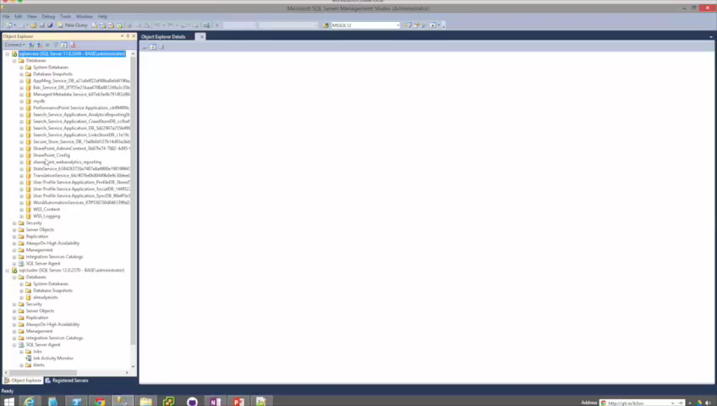
Copy Database Wizard demo
Notes:
Even speeding up the video still takes awhile to migrate just a few small databases. The mistake I made while filming this was genuine, too.

Slide 9
Login migration methods
SSIS Transfer Logins Task Very painful
changes passwords
disables account
does not transfer server roles or server permission sets
maintains SIDs
sp_help_revlogin Less painful, but still..
maintains passwords
maintains SIDs
does not transfer server roles or server permission sets
still manual / doesn’t scale well
Notes:
Microsoft provided the Transfer Logins Task within SSIS, which is based on SMO This method is extremely painful. It changes the passwords, disables the account, and doesn't transfer server roles of server permission sets. But! It does maintain the login SID.
Then there's sp_help_revlogin which you're probably familiar with
I once considered this stored procedure from Microsoft a god-send because it maintains the SIDS, migrates the password, and doesn't disable the account, however it also doesn't transfer server roles or server permission sets, and in my experience, most DBA's actually use this script as a starting point, and then build additional functionality on top of it.
Even then, it's still a manual process that doesn't scale well, especially when you are migrating logins for several servers, or want to migrate the logins on an ongoing basis.

Slide 10
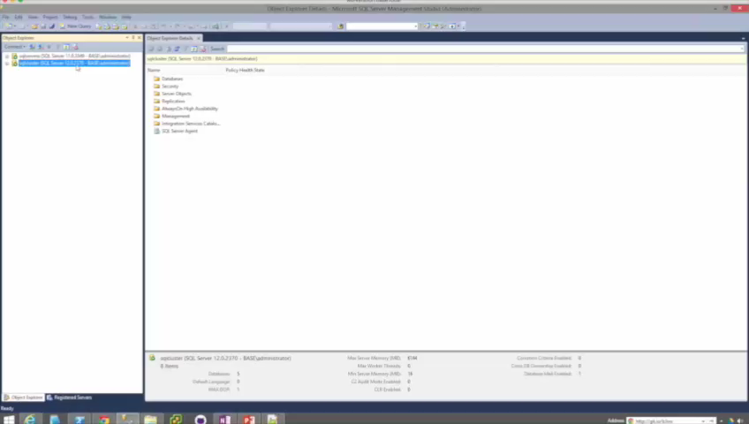
Login migrating using sp_help_revlogin
Notes:
This one is not sped up, so that you can be tortured along with me.

Slide 11
Migrating other stuff
Job Server Objects
AlwaysOn
SSMS / SMO / SSIS / restore msdb
Highly scriptable within SSMS & SMO
Server Configs
Database Mail
Use some T-SQL or SMO to craft some
T-SQL to execute some T-SQL
SMO, T-SQL, may include credentials
Linked Servers
Credentials
No way provided by Microsoft that includes passwords
No way provided by Microsoft that includes passwords
Finding SQL Server Keys
Central Management Server
Dig through the registry
Import/Export but sometimes errors on import
Notes:
There’s so much more, but here’s a start.
First, for the job sever otherwise known as SQL Server Agent, you can perform a migration in a variety of ways, up to and including restoring the msdb database, although that does introduce a few complexities, so I tend to migrate using scripts.
With AlwaysOn, this is also highly scriptable using SSMS and SMO.
sp_configure. now I've seen a few ways to do this, but mostly you use some T-SQL or SMO, to craft some T-SQL to execute on another SQL Server.
Central Management Server, does have built in import/export functionality, but you may encounter a terminating error on import when the destination CMS server name is contained within the XML import file.
Linked Servers, are challenging to migrate because of the way that the passwords are stored, that is, not within the database engine, but rather, encrypted deep within the registry. Same goes for Credentials.
Now when it comes to Finding your SQL Server key, this isn't too hard, there are scripts available online that will do it for you, but it does require digging through the registry if you're doing it manually. SQL keys ae useful for upgrading/downgrading editions.
And finally, database mail can be migrated using SMO, or T-SQL, but keep in mind that it may contain credentials, which brings us back to the challenge of decrypting these passwords in order to migrate the associated credential.

Slide 12
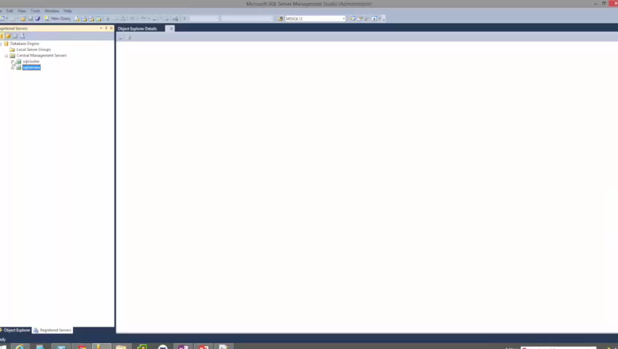
How CMS Import/Export usually goes
Notes:
There are very few situations where this doesn’t error out. I usually have to edit the XML to remove the duplicate server.

Slide 13

PowerShell, the better way.
dbatools
Copy-SqlLogin
Copy-SqlDatabase
Copy-SqlJobServer
Copy-SqlDatabaseMail
Copy-SqlBackupDevice
Copy-SqlServerTrigger
Copy-SqlLinkedServer
Copy-SqlCredential
Copy-SqlSysDBUserObjects
Copy-SqlCentralManagementServer
Export-SqlSpConfigure
Import-SqlSpConfigure
Start-SqlMigration
Get-SqlServerKey
Get-DetachedDBinfo
Get-SqlMaxMemory
Set-SqlMaxMemory
Import-CsvToSql
Reset-SqlAdmin
Restore-HallengrenBackup
Test-SqlConnection
Watch-SqlDbLogin
Update-dbatools
Remember: Get-Help
Notes:
Used to dread but now it’s fun
When I was preparing for my own migration at work, I thought there has to be a better way to do all of this. Initially, I was automating sp_help_revlogin and then I thought I should go to pure PowerShell, and that’s really where this all got started.
In the end, I compiled a number of scripts into a PowerShell module that I call dbatools that has a number of commands DBA’s are going to love.
When building these commands, I always try to support SQL Server 2000-2016, clusters, named instances, and all editions from Express to Enterprise. Most do require sysadmin access and will error out. If you have any questions, I do try my best to properly document each command.
Copy-SqlLogin
This command supports all editions of SQL Server 2000-2014, and it migrates both SQL Logins and Windows logins.
It can add, overwrite when force is specified, or sync. The sync switch syncs permissions, but does not add accounts.
If you do use force, force will drop and recreate the specified logins, except for the one executing the script, and the SQL Service account login.
By default, all logins are migrated. The include switch will only migrate the specified logins. It's also automatically populated by the logins on the source server for tab completion. Exclude logins will migrate ALL logins except for those specified.
Copy-SqlDatabase
Migrates in two ways: backup/restore and detach/attach
It does not migrate system databases, but can migrate support databases though this functionality is unsupported and incomplete.
Migrates including all file groups, filestreams and full-text indexes.
Supports NoRecovery!
Copy-SqlJobServer and Copy-SqlDatabaseMail are very basic, they just copy everything.
Copy-SqlLinkedServer and Copy-SqlCredential are also similar. You can specify which linked servers and credentials you want. Requires remote registry on.
Copy-SqlCentralManagementServer, copies all groups & subgroups.
Export-SqlSpConfigure to path. Import-SqlSpConfigure from file or from server.
Start-SqlMigration combines all of this!!! And transcribes!

Slide 14
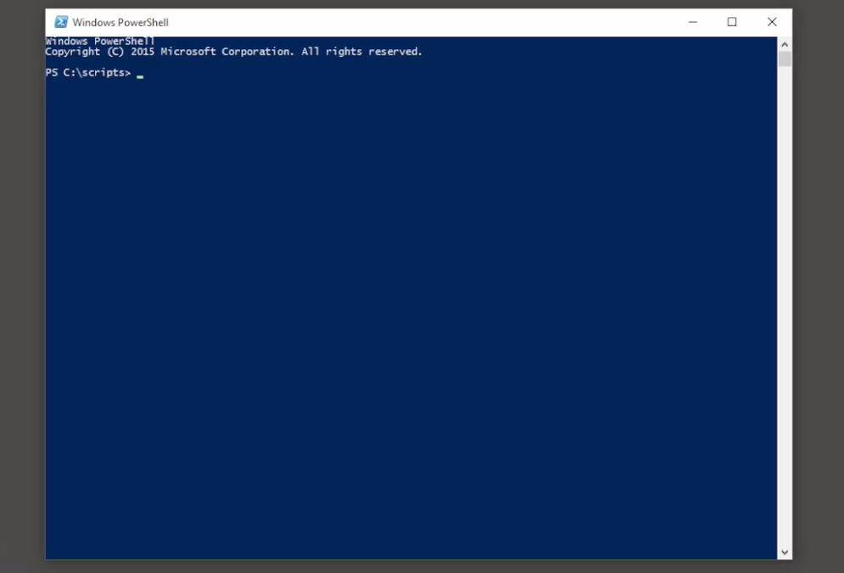
Import-CsvToSql
Notes:
Before we get into the demo, here’s a quick video of an import from CSV to SQL Server. This may seem fast, but with runspaces, it’s crazy faster. Check out my session on this topic if you’re interested.

Slide 15
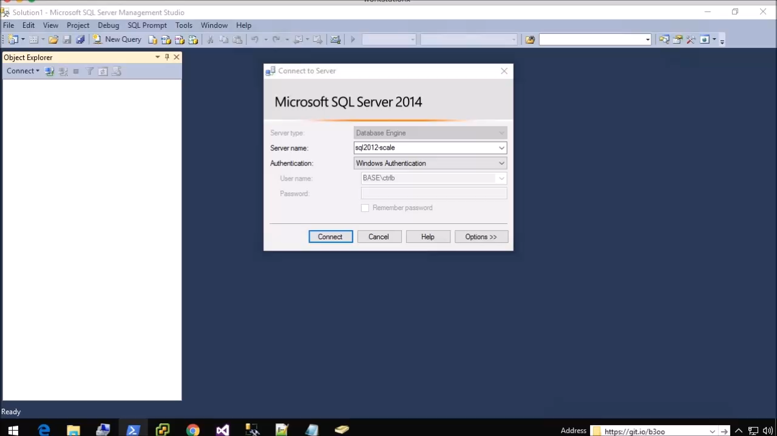
Reset-SqlAdmin
Notes:
This is a personal favorite. And it’s not just for sa or SQL Logins. You can even add Windows users/Groups.

Slide 16
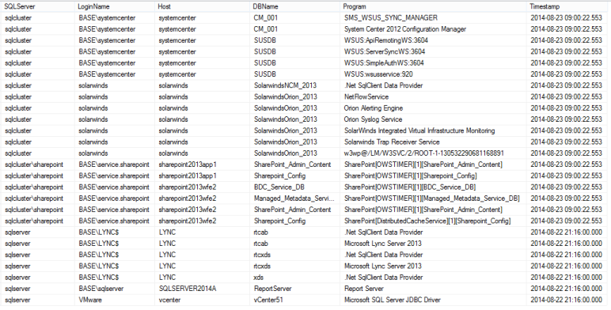
Watch-SqlDbLogin
... kind of a hack, but useful!
Notes:
Perhaps not the best approach, but it’s worked very well for me.

Slide 17
Demo
Using dbatools to migrate from a SQL Server 2012 instance to SQL Server 2016
* all databases from a default SharePoint install
Notes:
Demo time!

Slide 18
<# http://git.io/b3oo #>
# install the module (PS v3 and SMO required)
Invoke-Expression (Invoke-WebRequest -UseBasicParsing http://git.io/vn1hQ).Content
# Test Connection - I'll need this if you have issues.
Test-SqlConnection oldsql
# Change the max memory real quick
Get-SqlMaxMemory -SqlServers oldsql, newsql
Get-SqlMaxMemory -SqlServers oldsql, newsql | Where-Object {$_.SqlMaxMB -gt $_. TotalMB } | Set-SqlMaxMemory -UseRecommended
# Create new login called migrateme, then migrate.
Copy-SqlLogin -Source oldsql -Destination newsql -Logins migrateme -force
# Single database Detach/attach
Copy-SqlDatabase -source oldsql -Destination newsql -Detach -Reattach -Database sharepoint_webanalytics_reporting
# Detach/attach migration with a -whatif
Start-SqlMigration -Source oldsql -Destination newsql -Detach -Reattach -Whatif
# Actually do it.
Start-SqlMigration -Source oldsql -Destination newsql -BackupRestore -NetworkShare \\nas\share\Migration
# Restore Hallengren Backups
Restore-HallengrenBackup -SqlServer newsql -Path \\nas\share\SQLBACKUPS\staging -NoRecovery -Force
Notes:
# Pipe SQLPS' Get-Database to an Out-GridView to select just a few databases
# See example video here: https://twitter.com/cl/status/722152905340502017
Import-Module SQLPS
Get-SqlDatabase -ServerInstance oldsql | Out-GridView -PassThru | Copy-SqlDatabase -Destination newsql -BackupRestore –NetworkShare \\nas\share\Migration
# look at transcript
notepad .\dbatools-startmigration-transcript.txt

Slide 19
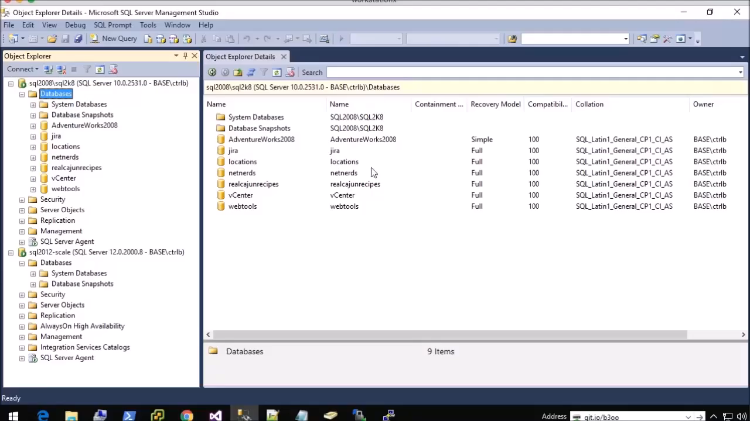
Bonus video! Fun with Out-Grid
Get-SqlDatabase is part of SQLPS so Import-Module SQLPS first!
Notes:
Get-SqlDatabase is part of SQLPS so Import-Module SQLPS first

Slide 20
Summary
PowerShell <3 SQL Server <3 PowerShell
Simplifies, and also prevents human error
No more checklists or boredom
Be a hero and impress your friends
Find it on github at git.io/b3oo
Notes:
Copy-SqlDatabase
SQL Server 2000-2014, clusters, named instances, all editions
DB – Backup/Restore & Detach/Attach
User objects in system databases (such as Hallengren’s scripts)
Complex file structures, FILESTREAM, file groups, full-text indexes
Move one, many or all databases
Command-line auto completion of databases
Automatically determines default data and log directories
Supports reusing exact folder structures
Copy-SqlLogin
SQL Server 2000-2014, clusters, named instances, all editions
Windows & SQL Authentication
SIDs, passwords, permission sets, roles, default db
SyncOnly option syncs permissions
Include or exclude any specific login (auto-completed)
Does not currently support certificate mapped or asymmetric keys
Does not migrate credentials. Use Copy-SQLCredential
Start-SqlMigration
Shortcut command to migrate entire instance, including databases, logins, credentials, linked servers, db mail, etc.
Copy-SqlCredential
Migrates passwords
Requires remote registry access
Copy-SqlLinkedServer
Migrates passwords
Migrates only if provider exists on destination server
Does not migrate ODBC connections (yet) or drivers
Does not copy over local files, such as SQLite databases
Requires remote registry access
Copy-SqlCentralManagementServer
Copies Registered Servers from CMS to CMS
Migrate one, multiple or all server groups
Get-SqlServerKey
SQL Server 2005-2014, clusters, named instances, all editions
Server list: command line, file, or Central Management Server
Finds keys for all instances on a server
Requires remote registry access for remote servers
Watch-SqlDbLogin
Helps find connstrings that need to be updated
Does not require SQL Server Auditing, but can be less accurate
Restore-HallengrenBackups
Restores Backups generated Ola Hallengren’s DBA scripts
Only supports default backup structure at this time
Can reuse advanced file structures found within backup file

Slide 21
Next Steps...
Now: 15 min break
Grab a coffee
Stay here to enjoy next presentation
Change track and switch to another room
Ask me questions or meet me in a breakout session room afterwards
Notes:
WOO

Slide 22
Questions?
Notes:
You can hit me up on Twitter, too. @cl

Slide 23
About_Author
SQL Server since 1999 and PowerShell since 2005
System Center Cloud and Datacenter Management MVP since 2015
DBA with General Dynamics IT at NATO Spec Ops HQ in Belgium
@cl on Twitter
Blogs at netnerds.net
Also RealCajunRecipes.com
Lead for the Belgian PowerShell User Group
Co-Lead for SQL PASS PowerShell Virtual Chapter
Please go upvote SQLPS cmdlets at sqlps.io/vote :D
Notes:
Thanks for reading!
Oh, and if you love PowerShell and SQL Server, please help make it better! Microsoft wants to hear your suggestions and opinions. Visit sqlps.io/vote to upvote the cmdlets you want to see in SQLPS.

